Slide 1
Application Architectures and Distribution
Dr David Wyatt
October 26

Slide 2
Session Plan
Enterprise Applications (EA)
Characteristics of EA
Types of EA
Software Architecture
Reuse
Repository Architecture
Client Server Architecture
Pipe and Filter Architecture
Layered Architecture
Distributed Architecture
The remaining time can be spent on assignment

Slide 3
Enterprise Applications (EA)
Enterprise Application
  Information Systems or Data Processing Systems
  Have complex data
  Work on / together with business rules
Include
  payroll, patient records, shipping tracking, cost analysis, credit scoring, insurance, supply chain, accounting, customer service, and foreign exchange trading
Don’t Include
  Word processors, elevator controllers, chemical plant controllers, telephone switches, operating systems, compilers, and games

Slide 4
Characteristics of EA
Persistent data
  On multiple runs of the program / persist for several years
  Changes to structure may happen
  New pieces of information do not disturb old information
Concurrent access to data
  From hundred to web-based magnitude
Different user interface screens
  Hundreds of distinct screens
Integration requirements
  Integrate with other enterprise applications scattered around the enterprise

Slide 5
Types of EA
Business to Customer (B2C) – E.g. Shopping Cart
  Handle a very high volume of users
  Scalable increase the load by adding more hardware
  Straightforward domain logic
  Generic Web presentation
  Simple Data sources , databases, inventory systems
Business to Business (B2B) – E.g. Leasing agreement
  fewer users
  complication is in the business logic
    e.g. early returns and late payments, and validating data as a lease is booked
  Complex user interface (UI)
    sophisticated presentation
    rich-client interface
    complicated transaction behaviour
  Complex database schema

Slide 6
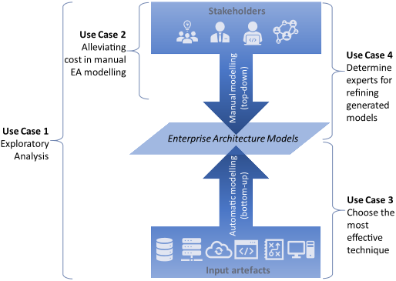
Software Architecture
Choose an architecture
  Understand the contextual problems of the system
  Choose an appropriate design
Identifying the sub-systems making up a system
Define the framework for sub-system control and communication
The output of this design process is a description of the software architecture.

Slide 7
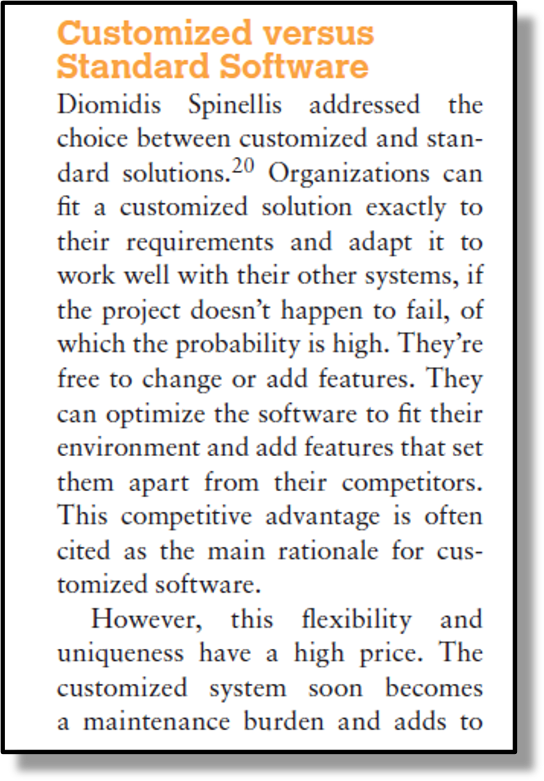
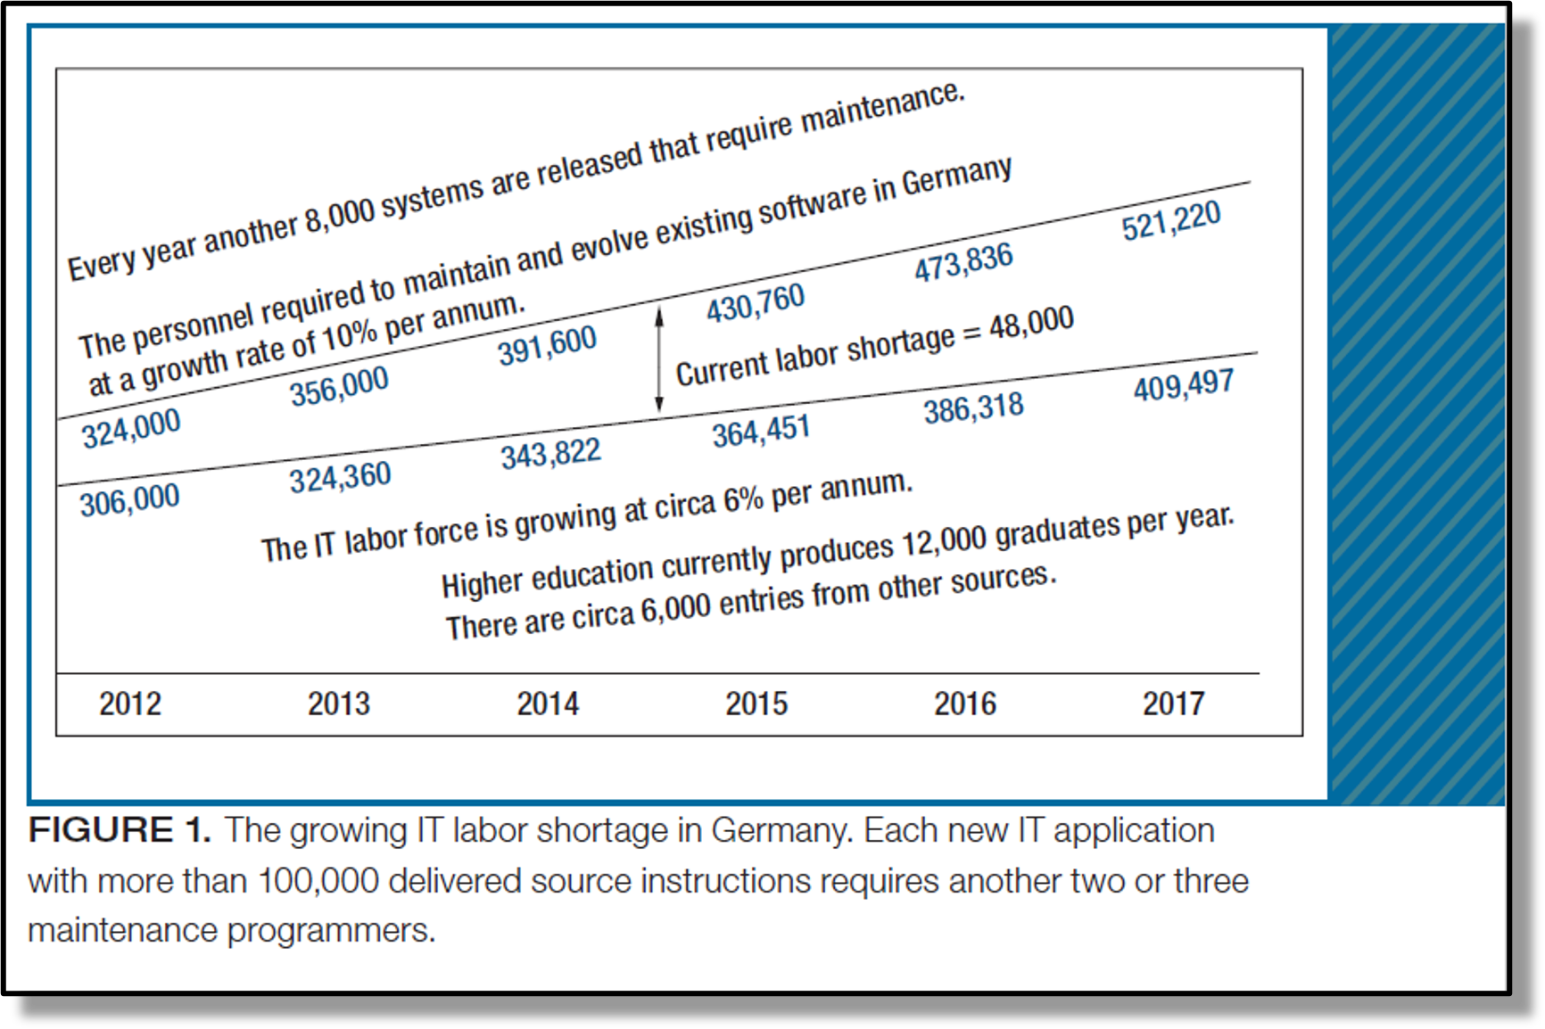
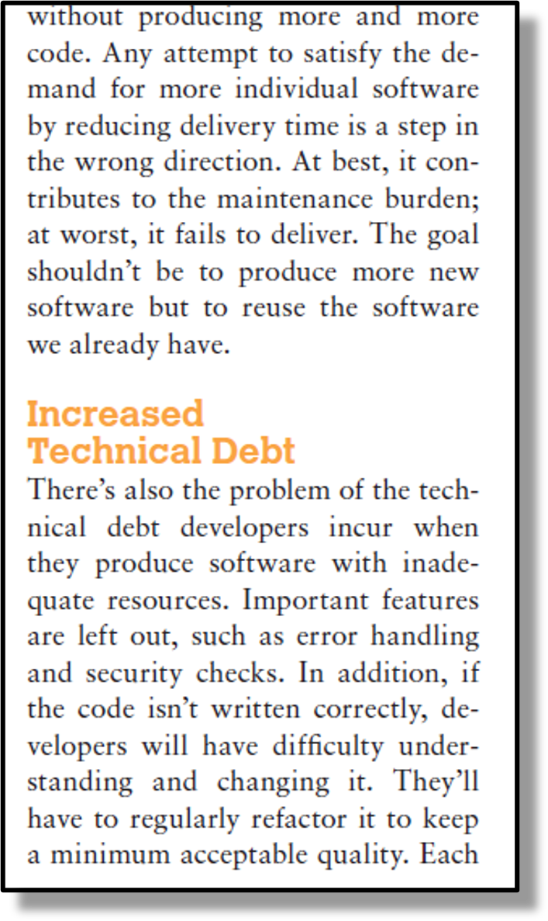
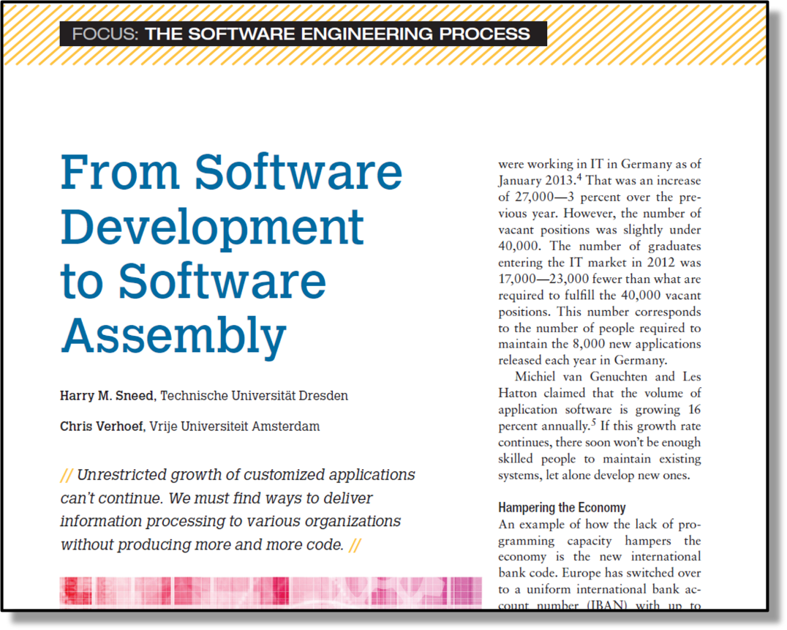
Architecture Reuse
Systems in the same domain often have similar architectures that reflect domain concepts
Variants to satisfy particular requirements
Design around one or more architectural patterns or ‘styles
  capture the essence
  instantiated in different ways

Slide 8
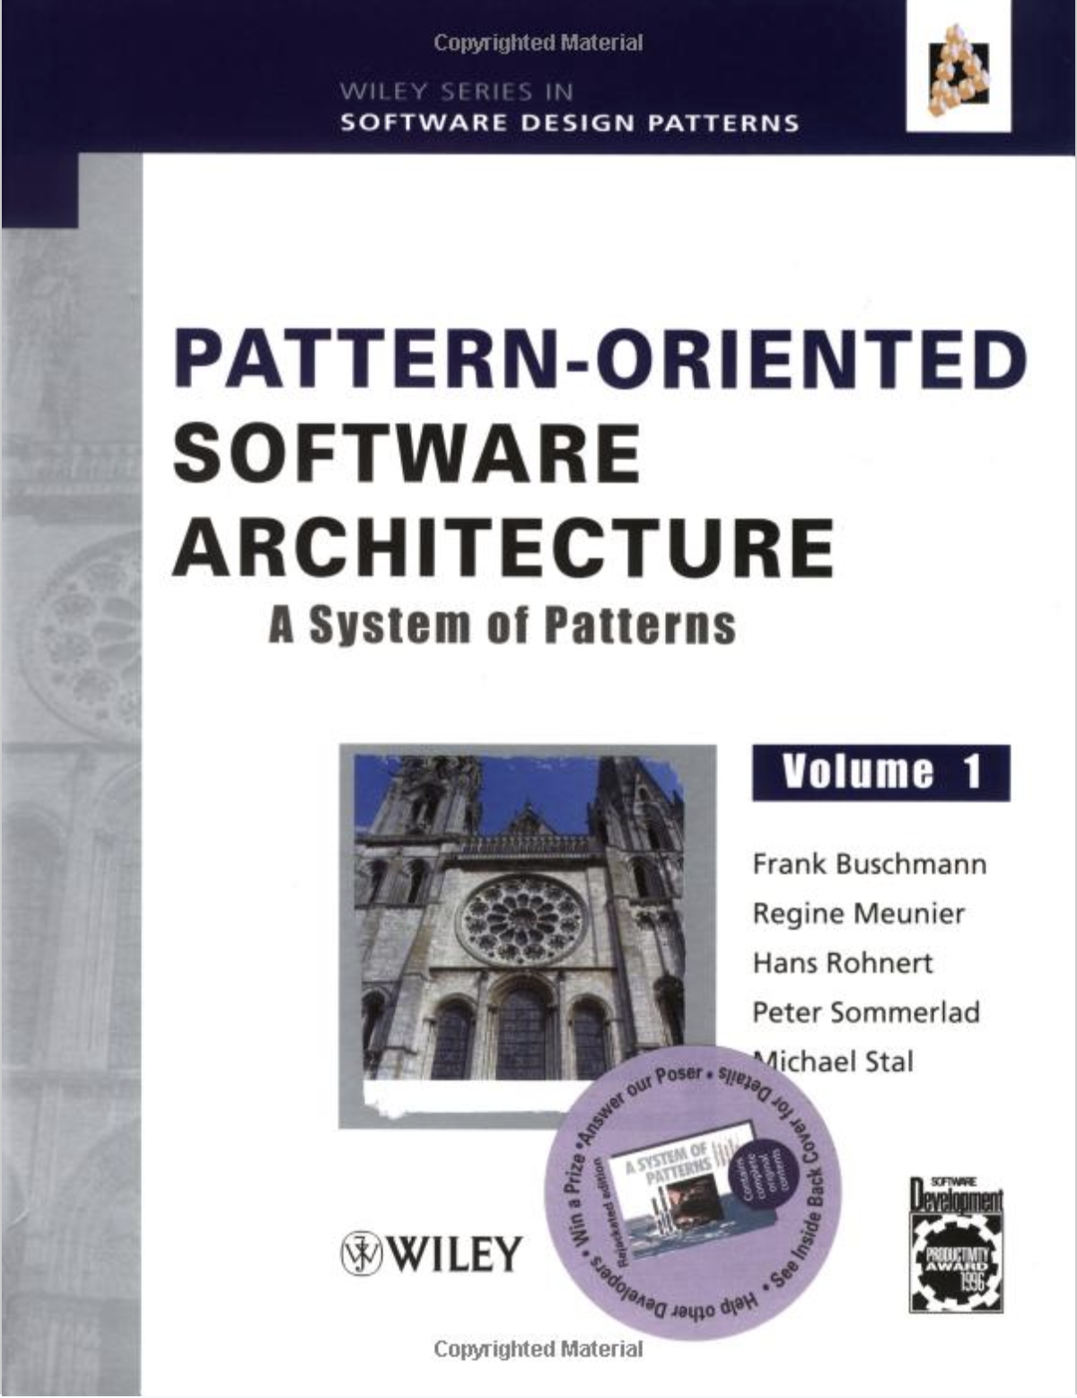
Recurring Architectural Patterns
Pattern Oriented Software Architecture
Remember Software and Architectural Design Patterns in Year 3
Sample patterns include:
  Repository
  Client Server
  Pipe & Filter
  Layered

Slide 9
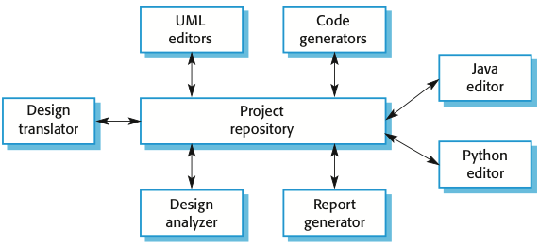
Repository Architecture
Sub-systems must exchange data. This may be done in two ways:
  Shared data is held in a central database or repository and may be accessed by all sub-systems;
  Each sub-system maintains its own database and passes data explicitly to other sub-systems.
When large amounts of data are to be shared, the repository model of sharing is most commonly used as this is an efficient data sharing mechanism.
Notes:
All data in a system is managed in a central repository
Accessible to all system components
Components do not interact directly
Only through the repository
Used When
large volumes of information are generated and stored for a long time
data-driven systems (data triggering actions)

Slide 10
Repository Architecture..
Advantages
  Scalability - new components can be added
  Concurrency - all components can work in parallel
  Reuse - components are not direct communication with each other
  Centralized data management
  Better conditions for security, archiving, etc.
  The components are independent of the manufacturer data
Disadvantages
  High dependence between the data structure of storage and components
  Storage - single point of failure (single point of failure)
  Changes in data structure strongly affect customers
  Multiple sync issues components

Slide 11
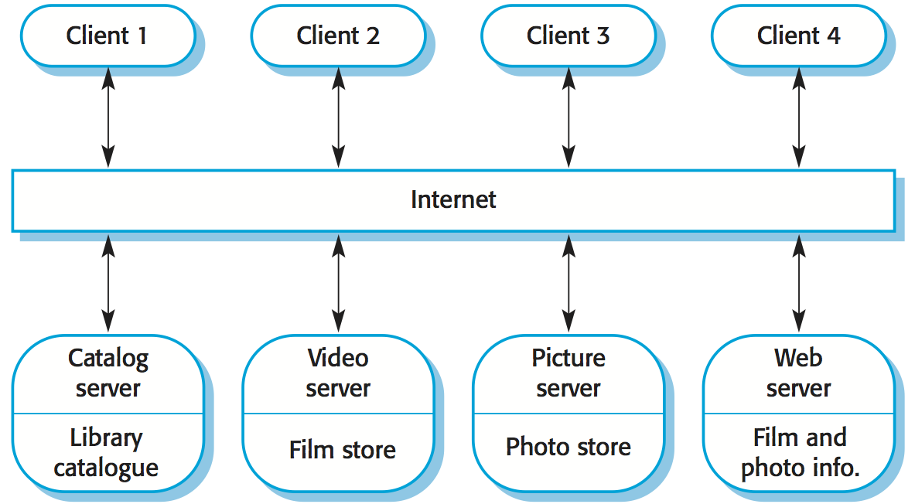
Client-server architecture
The functionality of the system is organised into services
  Each service is delivered from a separate server
  Clients are users of these services
Used When
  data in a shared database
  servers can be replicated
Notes:
Functionality of the system is organized into services
Each service delivered from a separate server
Clients are users of these services
Used When
data in a shared database
servers can be replicated

Slide 12
Client-server architecture..
Advantages
  Centralized architecture facilitates the protection of the data
  Servers can be distributed
  Data is transferred through protocols that are not of interest from the platforms
  Resource sharing
Disadvantages
  Productivity depends on the network as well as the system
  Each service is a single point of failure
  Susceptible to denial of service attack
  Performance depends on the network as well as the system

Slide 13
Thin and Fat clients
Thin-client
model
Server
Data Management Application processing
Client
Presentation
Server
Data Management
Fat-client
model
Client
Presentation
Application Processing

Slide 14
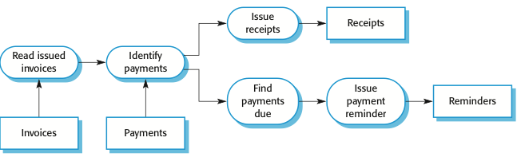

Pipe and filter architecture
Functional transformations process their inputs to produce outputs.
May be referred to as a pipe and filter model (as in UNIX shell).
Variants of this approach are very common. When transformations are sequential, this is a batch sequential model which is extensively used in data processing systems.
Not really suitable for interactive systems.

Slide 15
Pipe and filter example
Imagine a simple data processing system that reads a text file, converts all text to uppercase, removes any numbers, and then writes the cleaned text to a new file.
In a Pipe and Filter architecture, this could be broken down into:
    Read Filter: Reads the text file.
    Uppercase Filter: Converts all text to uppercase.
    Remove Numbers Filter: Removes any numeric characters.
    Write Filter: Writes the cleaned text to a new file.
Each filter performs a specific task, and the data flows through the pipeline from one filter to the next until the final output is produced.

Slide 16
Pipe and filter architecture..
Advantages
  Easy to understand
  Workflow style matches business processes
  Sequential or concurrent
Disadvantages
  data transfer has to be agreed
  Input – output must be agreed
  No reuse of transformations on incompatible data structures
  Difficult to share data
Notes:
Data flows (as in a pipe) from one component to another for processing
processing component (filter) is discrete and carries out one type of data transformation
Used When
in data processing applications
Inputs are processed in separate stages

Slide 17
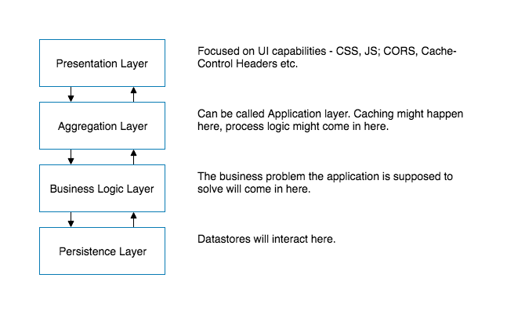
Layered architecture
Organizes the system into layers
Layers based on related functionality
Each layer offers services through an interface
Only the layer which is directly above can use the service from layer below
Thus, each layer represents:

Slide 18
Layering
Layering is a technique that software designers use to break apart a complicated software system
Subsystems are arranged where each layer rests on a lower layer
Higher layers use various services defined by the lower layer, but the lower layer is unaware of the higher layer
For example:
  FTP on top of TCP on top of IP on top of Ethernet

Slide 19
Layered Architecture
Advantages
  Single layer as a coherent whole
  Can substitute layers with alternative implementations
  Minimize dependencies between layers
  Layers make good places for standardization
  Expand to many higher-level services
Drawbacks
  Layers encapsulate some, but not all, things well
    A field on the UI, must be in the database, and thus to every layer in between
  Extra layers can harm performance

Slide 20
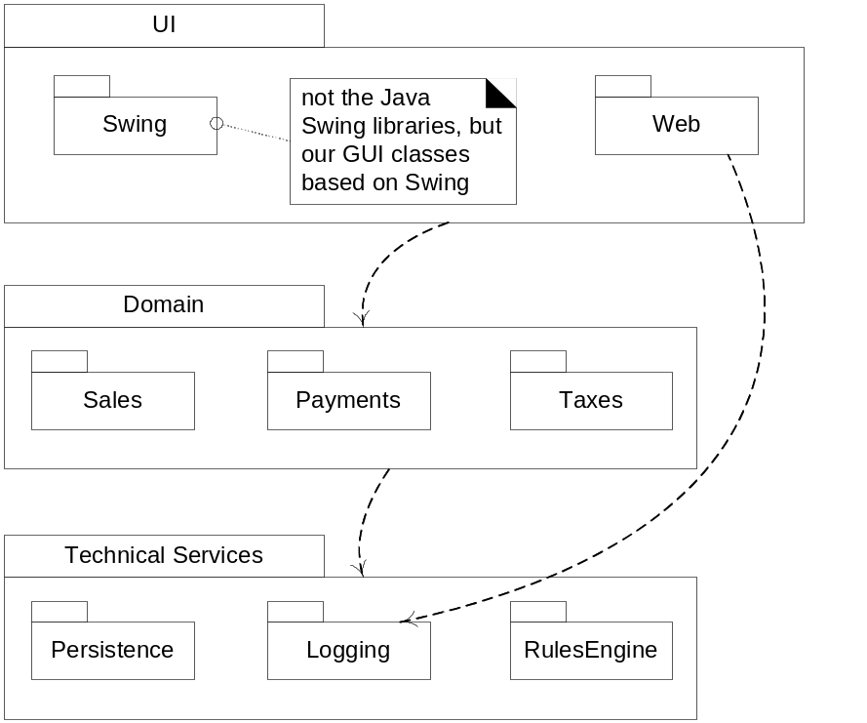
The Three Principal Layers
Layer | Responsibilities
Presentation | Provision of services, display of information (e.g., in Mobile, Windows or HTML, handling of user request)
Domain | Logic that is the real point of the system
Data Source | Communication with databases, messaging systems, transaction managers, other packages

Slide 21
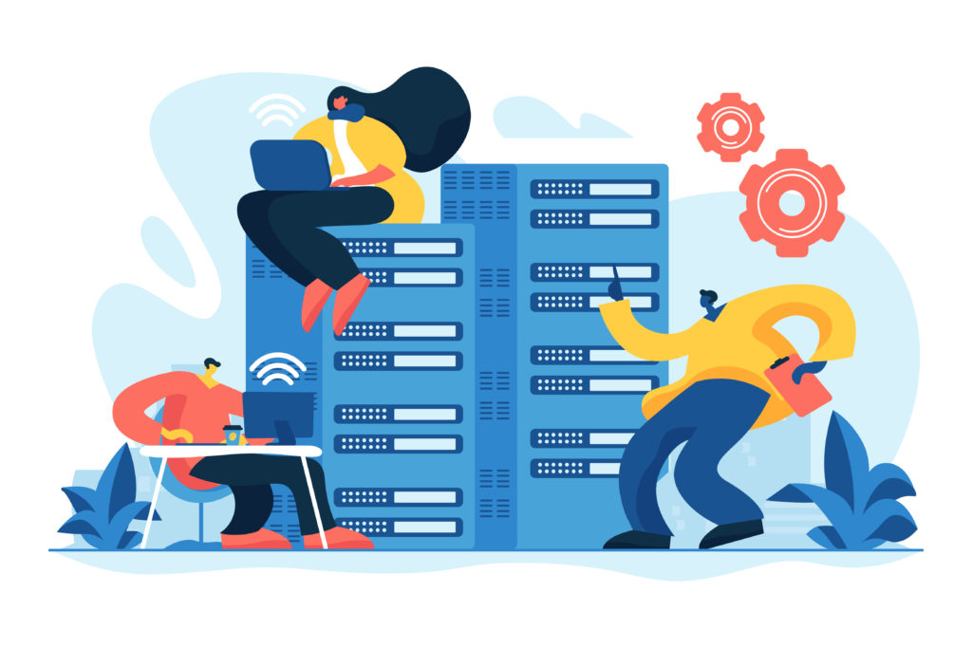
Distributed Systems Architectures
Architectural design for software that executes on more than one processor
Virtually all large computer-based systems are now distributed systems
Information processing is distributed over several computers rather than confined to a single machine
Distributed software engineering is now very important

Slide 22
Distributed System Characteristics
Resource sharing
  Sharing of hardware and software resources.
Openness
  Use of equipment and software from different vendors.
Concurrency
  Concurrent processing to enhance performance.
Scalability
  Increased throughput by adding new resources.
Fault tolerance
  The ability to continue in operation after a fault has occurred.

Slide 23
Distributed System Disadvantages
Complexity
  Typically, distributed systems are more complex than centralised systems.
Security
  More susceptible to external attack.
Manageability
  More effort required for system management.
Unpredictability
  Unpredictable responses depending on the system organisation and network load.

Slide 24
Distributed Systems Architectures..
Client-server architectures
  Distributed services which are called on by clients. Servers that provide services are treated differently from clients that use services.
Distributed Object architectures
  No distinction between clients and servers. Any object on the system may provide and use services from other objects.

Slide 25
Middleware
Software that manages and supports the different components of a distributed system.
In essence, it sits in the middle of the system.
Middleware is usually off-the-shelf rather than specially written software.
Examples
  Transaction processing monitors;
  Data converters;
  Communication controllers.

Slide 26
Middleware in Distributed Systems
Middleware hides some of the complexity of distribution.
Provides common services between applications.
Typical responsibilities include:
  communication
  message routing
  data conversion
  transaction management
  authentication/security
  service discovery
Middleware lets components interact without each component having to implement all communication and integration logic itself.

Slide 27
Message-Based Integration
Systems exchange messages through a broker, queue, or event bus.
Sender and receiver do not need to run at the same time.
Supports asynchronous communication.
Reduces direct dependencies between systems.
Useful when integrating multiple enterprise applications or services.
Can improve scalability and resilience.
The sender does not need to know exactly how each receiving system works.

Slide 28
Data Consistency in Distributed Systems
In a distributed system, multiple services may hold copies of related data.
Updating one system does not automatically update all others immediately.
Network delay or failure can create temporary inconsistencies.
Two common approaches:
  Strong consistency — all components see the latest value before processing continues.
  Eventual consistency — updates may take time to propagate, but systems should converge later.
Trade-off:
  stronger consistency can reduce availability/performance;
  looser consistency improves scalability and resilience but may allow temporary mismatch.

